Slide 1
Short range Obstacle Avoiding robot
A Presentation on how to Develop Obstacle Avoiding Robot

Slide 2
A Brief Summary On Robotics:
Robotics is an interesting and fast growing field. Being a branch of engineering, the applications of robotics are increasing with the advancement of technology. The concept of Mobile Robot is fast evolving and the number of mobile robots and their complexities are increasing with different applications. There are many types of mobile robot navigation techniques like path planning, self – localization and map interpreting. An Obstacle Avoiding Robot is a type of autonomous mobile robot that avoids collision with unexpected obstacles.

Slide 3
Obstacle Avoiding Robot:
Obstacle Avoiding robot is mainly used in Areas that Human race are not yet derived, example outside Space And Other Planets.
These robots can avoid any obstacles and can even spy.
These robots are now approved by various military organizations, such as Pentagon Of US Military, DRDO Of Indian Defense, etc.

Slide 4
Parts And Accessories Needed:
Arduino Uno R3
Chassis Body (with 4 flat wheels and a Castrol wheel)
Breadboard
Motor Driver Module -L293D
Jumper wires
9V Batteries (x4)
Ultrasonic Sensor -HC SR04

Slide 5
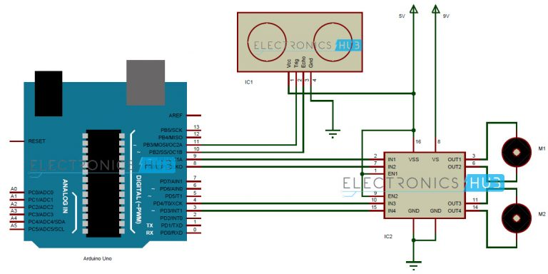
Planning Of Parts:

Slide 6
Planning And Connections:
As we saw the connections in the Above Photo, we are not going to connect the Wires from one object to another.
In this step, we will use a new object called “Breadboard”.
Breadboard is a construction base for prototyping of electronics. It is very easy to prototype and hence help engineers and prototypers to make their projects easy.

Slide 7
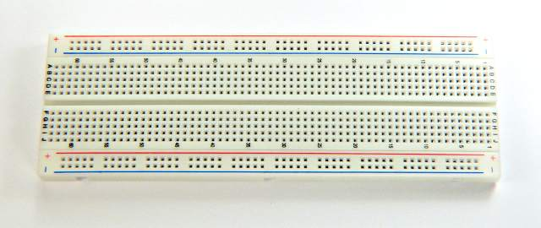
Breadboard:

Slide 8
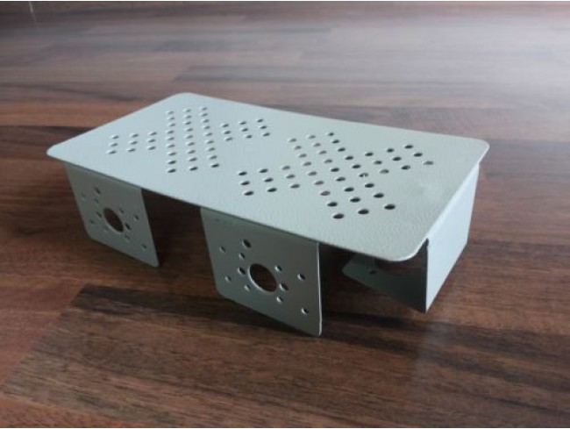
Getting Robot Body Ready(Chassis)
When Picking a chassis, always use a good metal chassis.
Metal chassis can support all types of projects.
Always remember to install an insulator before placing parts, as they can short your circuit/project.

Slide 9
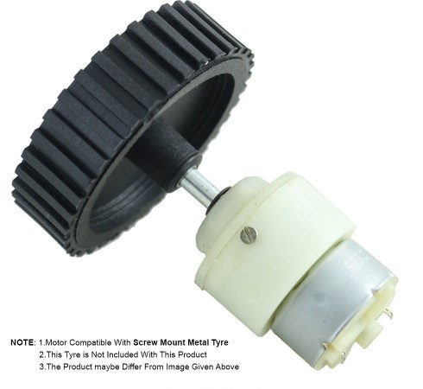
Placing Your Motors:
As we know, for the movement, we have place 2 wheels with motors.
Always use a Geared Motor as it can control speed.
Consider Left motor as 1st motor and Right motor as 2nd motor.

Slide 10
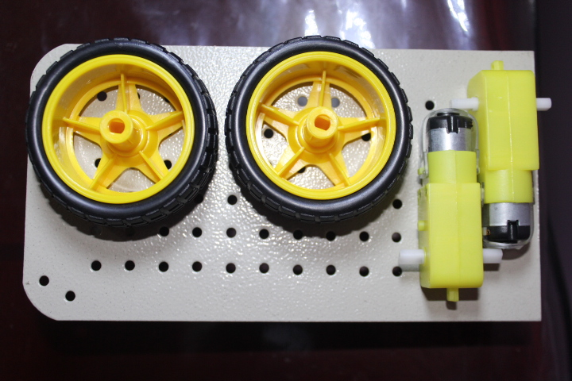
Body And Wheels Assembling:
First of all, when starting to assemble parts, always use good parts as the cheap ones can easily be damaged.
Make sure that the Gear motor alignment should be perfect for screws to fit in.

Slide 11
Arduino Uno R3:
The Arduino Uno is the most important circuit, to run this Robot. The Arduino Uno contains ATmega328 microcontroller, which can be programmed with Basic Language.
It Contains 14 Digital I/O Pins, 6 Analog Inputs, 3 GND outputs, 3.3V and 5V output pins.
It has a flash memory of 32K to store the program.
The Arduino Clock or crystal has a speed of 16Mhz, which gives a fast boot to the robot and the accessories.

Slide 12
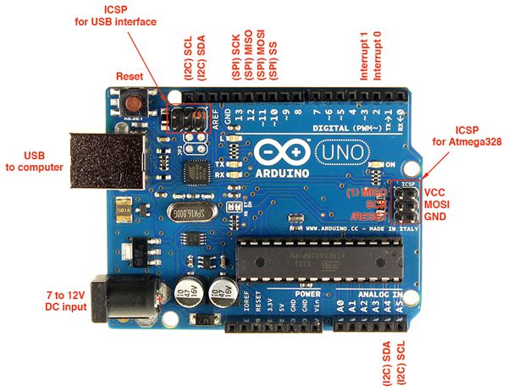
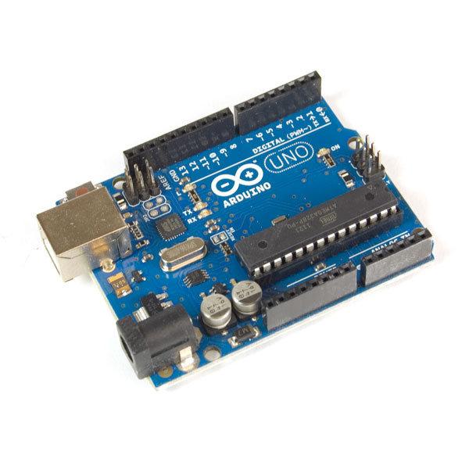
Arduino Uno R3:

Slide 13
Ultrasonic Sensor HC-SR04
Ultrasonic ranging module HC - SR04 provides 2cm - 400cm non-contact measurement function, the ranging accuracy can reach to 3mm. The modules includes ultrasonic transmitters, receiver and control circuit. The basic principle of work:
Using IO trigger for at least 10us high level signal,
The Module automatically sends eight 40 kHz and detect whether there is a pulse signal back.
IF the signal back, through high level , time of high output IO duration is the time from sending ultrasonic to returning.
Test distance = (high level time×velocity of sound (340M/S) / 2

Slide 14
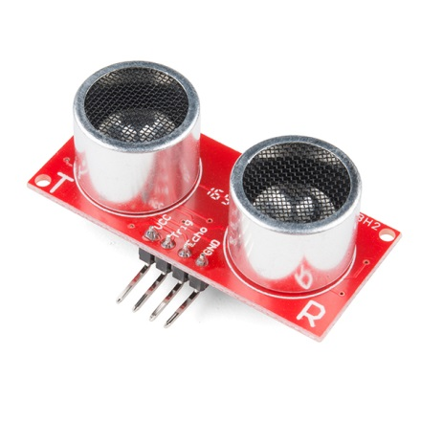
Ultrasonic Sensor HC-SR04:

Slide 15
Motor Driver Module-L293D
L293D is a typical Motor driver or Motor Driver IC which allows DC motor to drive on either direction.
L293D is a 16-pin IC which can control a set of two DC motors simultaneously in any direction. It means that you can control two DC motor with a single L293D IC.
It works on the concept of H-bridge. H-bridge is a circuit which allows the voltage to be flown in either direction.

Slide 16
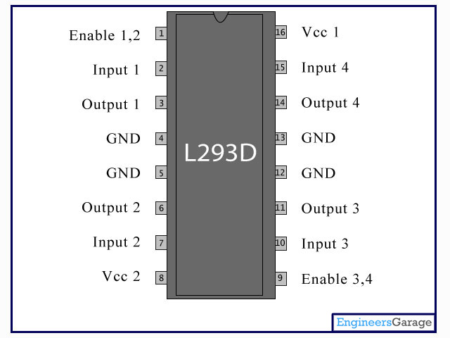
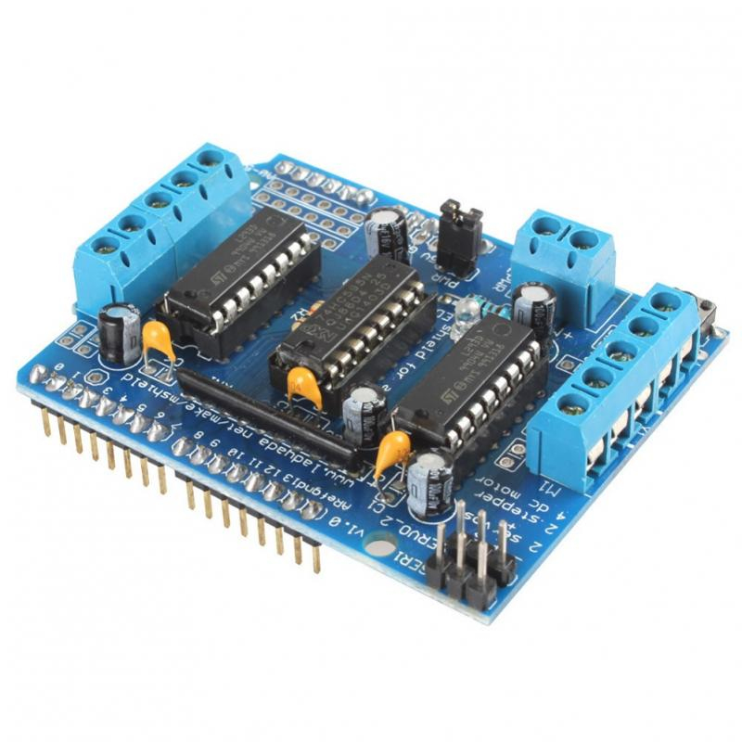
Motor Driver Module-L293D:

Slide 17
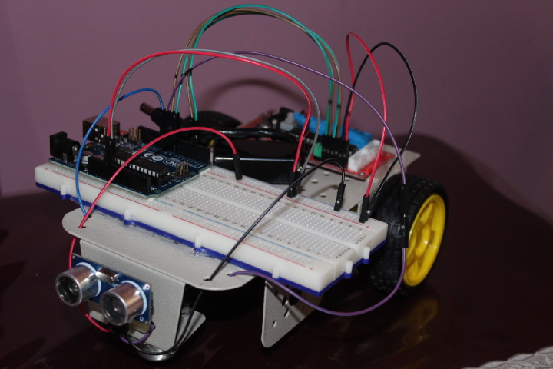
Final Assembly of Robot:
This Is our final assembly of the robot.
We have tested our code and wiring assignment and the result was,
The robot avoid any obstacles, which comes in its path if the obstacle is 15cm ahead.

